Slide 1
Javascript And HTML Forms
IN712 Web 3

Slide 2
HTML Forms
Forms provide you with a way of grouping together HTML interaction elements with a common purpose
For example, a form may contain elements that enable the input of a user’s data for registering on a website
To create a form, use the <form> and </form> tags to declare where the form element starts and where it ends
The action attribute determines where the form is submitted
The method attribute determines how the information is submitted
The target attribute determines the frame to which the response to the form is loaded.
Generally speaking, for client‐side scripting where you have no intention of submitting information to a server yet, these attributes are not necessary
The only attribute you need is the name attribute, so that you can reference the form

Slide 3
A review of the HTTP protocol
If the server exists and accepts the connection, the browser sends something like this:
The Hypertext Transfer Protocol is the mechanism through which data is requested and provided on the World Wide Web
If you type https://www.op.ac.nz/study/index.html into your browser’s address bar, the browser first looks up the address of the server associated with https://www.op.ac.nz and tries to open a TCP connection to it on port 80, the default port for HTTP traffic. It then tries to fetch the resource at path ./study/index.html
GET /study/index.html HTTP/1.1
Host: op.ac.nz
User-Agent: Your browser's name
Then the server responds, through that same connection.
HTTP/1.1 200 OK
Content-Length: 65585
Content-Type: text/html
Last-Modified: Wed, 08 Feb 2016 11:25:17 GMT
<!doctype html> ... the rest of the HTML document
The browser then takes the part of the response after the blank line and renders it as an HTML document.

Slide 4
HTTP request
The information sent by the client is called the request. It starts with this line GET /study/index.html HTTP/1.1
The first word is the method of the request. GET means that we want to get the specified resource. Other common methods are DELETE to delete a resource, PUT to replace it, and POST to send information to it.
Note that the server is not obliged to carry out every request it gets. If you walk up to a random website and tell it to DELETE its main page, it’ll probably refuse.
The part after the method name is the path of the resource the request applies to.
Many servers generate the responses they produce on the fly. For example, if you open facebook/someuser, the server looks in its database for a user named someuser, and if it finds one, it will generate a profile page for that user.
After the resource path, the first line of the request mentions HTTP/1.1 to indicate the version of the HTTP protocol it is using.

Slide 5
HTTP response
The server’s response will start with the HTTP version, followed by the status of the response, first as a three-digit status code and then as a human-readable string.
Status codes starting with a 2 indicate that the request succeeded. Codes starting with 4 mean there was something wrong with the request.
404 is probably the most famous HTTP status code—it means that the resource that was requested could not be found.
Codes that start with 5 mean an error happened on the server and the request is not to blame.
HTTP/1.1 200 OK

Slide 6
HTTP Headers
The first line of an HTTP request or HTTP response may be followed by any number of headers.
These are lines in the form “name: value” that specify extra information about the request or response.
HTTP REQUEST
HTTP RESPONSE
HTTP/1.1 200 OK
Content-Length: 65585
Content-Type: text/html
Last-Modified: Wed, 08 Feb 2016 11:25:17 GMT
<!doctype html> ... the rest of the document 111
GET /study/index.html HTTP/1.1
Host: op.ac.nz
User-Agent: Your browser's name
After the headers, both requests and responses may include a blank line followed by a body, which contains the data being sent.
GET and DELETE requests don’t send along any data, but PUT and POST requests do.
Similarly, some response types, such as error responses, do not require a body.
Notes:
For the most part, a client or server decides which headers to include in a request or response, though a few headers are required. For example, the Hostheader, which specifies the hostname, should be included in a request because a server might be serving multiple hostnames on a single IP address, and without that header, the server won’t know which host the client is trying to talk to.

Slide 7
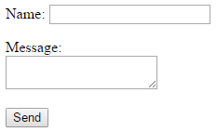
Introduction to forms
HTML pages may include forms, which allow the user to fill out information and send it to the server.
<form method="GET" action="example/someAction.php">
<p>Name: <input type="text" name="name"></p>
<p>Message:<br>
<textarea name="message"></textarea></p>
<p><button type="submit">Send</button></p>
</form>
When you click the Send button, the information in those fields will be encoded into a query string.
When the <form> element’s method attribute is GET (or is omitted), that query string is tacked onto the action URL, and the browser makes a GET request to that URL.
The start of a query string is indicated by a question mark. After that follow pairs of names and values, corresponding to the name attribute on the form field elements and the content of those elements, respectively.
An ampersand character (&) is used to separate the pairs.
GET /example/someAction.php?name=David&message=Yes%3F HTTP/1.1

Slide 8
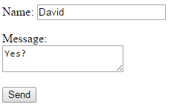
URL Encoding
GET /example/message.html?name=David&message=Yes%3F HTTP/1.1
The actual message encoded in the previous URL is “Yes?”, even though the question mark is replaced by a code.
Some special characters in query strings must be escaped. The question mark, represented as %3F, is one of those.
This encoding is called URL encoding
It uses a percent sign followed by two hexadecimal digits that encode the character code. In this case, 3F, which is 63 in decimal notation, is the code of a question mark character.
JavaScript provides the encodeURIComponent and decodeURIComponent functions to encode and decode this format.
console.log(encodeURIComponent("Hello & goodbye"));
console.log(decodeURIComponent("Hello%20%26%20goodbye"));

Slide 9
Form POST request
If we change the method attribute of the HTML form in the example we saw earlier to POST, the HTTP request made to submit the form will use the POST method and put the query string in body of the request, rather than adding it to the URL.
<form method="GET" action="example/message.html">
<p>Name: <input type="text" name="name"></p>
<p>Message:<br>
<textarea name="message"></textarea></p>
<p><button type="submit">Send</button></p>
</form>
<form method=“POST" action="example/message.html">
<p>Name: <input type="text" name="name"></p>
<p>Message:<br>
<textarea name="message"></textarea></p>
<p><button type="submit">Send</button></p>
</form>
POST /example/message.html
HTTP/1.1 Content-length: 24
Content-type: application/x-www-form-urlencoded
name=David&message=Yes%3F
GET /example/message.html?name=David&message=Yes%3F HTTP/1.1
By convention, the GET method is used for requests that do not have side effects, such as doing a search. Requests that change something on the server, such as creating a new account or posting a message, should be expressed with other methods, such as POST.

Slide 10
Form Elements

Slide 11
Common Properties and Methods of Form Elements
name Property: common to all form elements.
You can use the value of this property to reference that particular element in your script.
If you are sending the information in the form to a server, the element’s name property is sent along with any value of the form element, so that the server knows what the value relates to
value Property: returns the value of the element. For example, for a text box, the value property returns the text that the user entered in the text box.
form Property: returns the Form object in which the element is contained.
type property: returns the type of the element (for example, button or text).

Slide 12
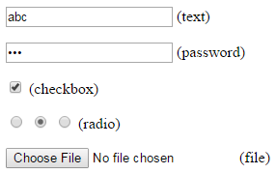
Fields
A web form consists of any number of input fields grouped in a <form> tag.
A lot of field types use the <input> tag. This tag’s type attribute is used to select the field’s style.
Form fields do not necessarily have to appear in a <form> tag. You can put them anywhere in a page. Such fields cannot be submitted (only a form as a whole can), but when responding to input with JavaScript, we often do not want to submit our fields normally anyway.
The JavaScript interface for such elements differs with the type of the element.
<p><input type="text" value="abc"> (text)</p>
<p><input type="password" value="abc"> (password)</p>
<p><input type="checkbox" checked> (checkbox)</p>
<p><input type="radio" value="A" name="choice">
<input type="radio" value="B" name="choice" checked>
<input type="radio" value="C" name="choice"> (radio)</p>
<p><input type="file"> (file)</p>

Slide 13


Focus
Unlike most elements in an HTML document, form fields can get keyboard focus. When clicked—or activated in some other way—they become the currently active element, the main recipient of keyboard input.
We can control focus from JavaScript with the focus and blur methods. The first moves focus to the DOM element it is called on, and the second removes focus. The value in document.activeElement corresponds to the currently focused element.
<input type="text">
<script>
document.querySelector("input").focus();
console.log(document.activeElement.tagName);
document.querySelector("input").blur();
console.log(document.activeElement.tagName);
</script>
Notes:
If a document has a text field, text typed will end up in there only when the field is focused. Other fields respond differently to keyboard events. For example, a <select> menu tries to move to the option that contains the text the user typed and responds to the arrow keys by moving its selection up and down.

Slide 14
Focus
JavaScript can be used to focus this field when the document is loaded, but HTML also provides the autofocus attribute, which produces the same effect but lets the browser know what we are trying to achieve.
<input type="text" autofocus>
Browsers traditionally also allow the user to move the focus through the document by pressing the Tab key. We can influence the order in which elements receive focus with the tabindex attribute
By default, most types of HTML elements cannot be focused. But you can add a tabindex attribute to any element, which will make it focusable.
The following example document will let focus jump from the text input to the OK button, rather than going through the help link first:
<input type="text" tabindex=1> <a href=".">(help)</a>
<button onclick="console.log('ok')" tabindex=2>OK</button>

Slide 15
Disabled fields
All form fields can be disabled through their disabled attribute, which also exists as a property on the element’s DOM object.
Disabled fields cannot be focused or changed, and unlike active fields, they usually look gray and faded.
When a program is in the process of handling an action caused by some button or other control, which might require communication with the server and thus take a while, it can be a good idea to disable the control until the action finishes. That way, when the user gets impatient and clicks it again, they don’t accidentally repeat their action.
<button>Yes</button>
<button disabled>No</button>

Slide 16


The form element
When a field is contained in a <form> element, its DOM element will have a property form linking back to the form’s DOM element. The <form> element, in turn, has a property called elements that contains an array-like collection of the fields inside it
The name attribute of a form field determines the way its value will be identified when the form is submitted. It can also be used as a property name when accessing the form’s elements property, which acts both as an array-like object (accessible by number) and a map (accessible by name).
<form action="example/submit.html">
Name: <input type="text" name="name"><br>
Password: <input type="password" name="password">
<br>
<button type="submit">Log in</button>
</form>
<script>
var form = document.querySelector("form");
var nameInput = document.querySelector("input");
console.log(form.elements[1].type);
console.log(form.elements.password.type);
console.log(form.elements.name.form == form);
console.log(nameInput.form);
</script>

Slide 17

Intercepting submit events
A button with a type attribute of submit will, when pressed, cause the form to be submitted.
Submitting a form normally means that the browser navigates to the page indicated by the form’s action attribute, using either a GET or a POST request. But before that happens, a "submit" event is fired. This event can be handled by JavaScript, and the handler can prevent the default behavior by calling preventDefault on the event object.
Intercepting "submit" events in JavaScript has various uses. We can write code to verify that the values the user entered make sense and immediately show an error message instead of submitting the form when they don’t.
Or we can disable the regular way of submitting the form entirely, as in the previous example, and have our program handle the input asynchronously
<form action="example/submit.html">
Value: <input type="text" name="value">
<button type="submit">Save</button>
</form>
<script>
var form = document.querySelector("form");
form.addEventListener("submit", function(event) {
console.log("doing something asynchronously“, form.elements.value.value);
event.preventDefault();
});
</script>

Slide 18

Text fields
Fields created by <input> tags with a type of text or password, as well as textarea tags, share a common interface. Their DOM elements have a value property that holds their current content as a string value. Setting this property to another string changes the field’s content.
The "change" event for a text field does not fire every time something is typed. Rather, it fires when the field loses focus after its content was changed. To respond immediately to changes in a text field, you should register a handler for the "input" event instead, which fires for every time the user types a character, deletes text, or otherwise manipulates the field’s content.
<input type="text"> length: <span id="length">0</span>
<script>
var text = document.querySelector("input");
var output = document.querySelector("#length");
text.addEventListener("input", function() {
output.textContent = text.value.length;
});
</script>

Slide 19


Checkboxes
A checkbox field is a simple binary toggle. Its value can be extracted or changed through its checked property, which holds a Boolean value.
The <label> tag is used to associate a piece of text with an input field. Its for attribute should refer to the id of the field.
<input type="checkbox" id="purple">
<label for="purple">Make this page purple</label>
<script>
var checkbox = document.querySelector("#purple");
checkbox.addEventListener("change", function() {
document.body.style.background =
checkbox.checked ? "mediumpurple" : "";
});
</script>

Slide 20




Radio buttons
A radio button is similar to a checkbox, but it’s implicitly linked to other radio buttons with the same name attribute so that only one of them can be active at any time
Color:
<input type="radio" name="color" value="mediumpurple"> Purple
<input type="radio" name="color" value="lightgreen"> Green
<input type="radio" name="color" value="lightblue"> Blue
<script>
var buttons = document.getElementsByName("color");
function setColor(event) {
document.body.style.background = event.target.value;
}
for (var i = 0; i < buttons.length; i++)
buttons[i].addEventListener("change", setColor);
</script>

Slide 21


Select fields
Select fields are conceptually similar to radio buttons—they also allow the user to choose from a set of options.
But where a radio button puts the layout of the options under our control, the appearance of a <select> tag is determined by the browser.
Select fields also have a variant that is more akin to a list of checkboxes, rather than radio boxes. When given the multiple attribute, a <select> tag will allow the user to select any number of options, rather than just a single option.
<select >
<option>BMW</option>
<option>Ford</option>
<option>Toyota</option>
<option>Audi</option>
<option>Mercedes</option>
</select>
<select multiple>
<option>BMW</option>
<option>Ford</option>
<option>Toyota</option>
<option>Audi</option>
<option>Mercedes</option>
</select>

Slide 22

Select fields
The value property of a <select> element reflects the currently selected option.
For a multiple field, though, this property doesn’t mean much since it will give the value of only one of the currently selected options.
The <option> tags for a <select> field can be accessed as an array-like object through the field’s options property. Each option has a property called selected, which indicates whether that option is currently selected.
<select multiple>
<option value="1">0001</option>
<option value="2">0010</option>
<option value="4">0100</option>
<option value="8">1000</option>
</select> = <span id="output">0</span>
<script>
var select = document.querySelector("select");
var output = document.querySelector("#output");
select.addEventListener("change", function() {
var number = 0;
for (var i = 0; i < select.options.length; i++) {
var option = select.options[i];
if (option.selected)
number += Number(option.value);
}
output.textContent = number;
});
</script>

Slide 23


File Fields
File fields were originally designed as a way to upload files from the browser’s machine through a form.
In modern browsers, they also provide a way to read such files from JavaScript programs.
The field acts as a manner of gatekeeper.
The script cannot simply start reading private files from the user’s computer, but if the user selects a file in such a field, the browser interprets that action to mean that the script may read the file.
The files property of a file field element is an array-like object containing the files chosen in the field
<script>
var input = document.querySelector("input");
input.addEventListener("change", function() {
if (input.files.length > 0) {
var file = input.files[0];
console.log("You chose", file.name);
if (file.type)
console.log("It has type", file.type);
}
});
</script>

Slide 24
File Fields
Since reading a file from disk can take time, the interface will have to be asynchronous to avoid freezing the document.
Reading a file is done by creating a FileReader object, registering a "load" event handler for it, and calling its readAsText method, giving it the file we want to read.
Once loading finishes, the reader’s result property contains the file’s content.
<input type="file" multiple>
<script>
var input = document.querySelector("input");
input.addEventListener("change", function() {
Array.prototype.forEach.call(input.files, function(file) {
var reader = new FileReader();
reader.addEventListener("load", function() {
console.log("File", file.name, "starts with", reader.result.slice(0, 20));
});
reader.readAsText(file);
});
});
</script>

Slide 25
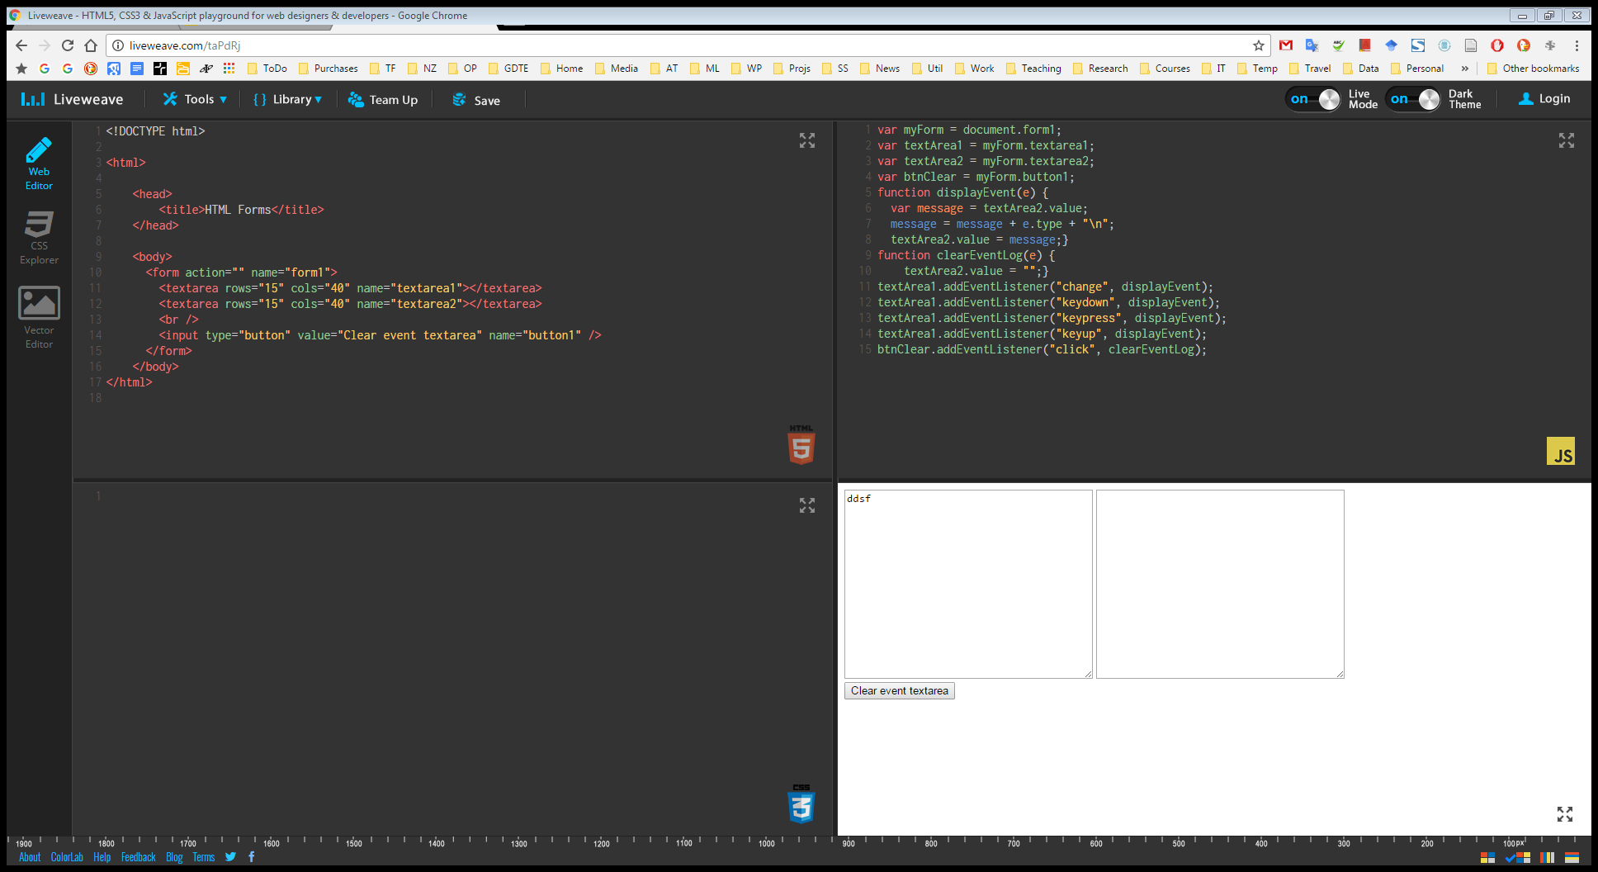
Demo 1

Slide 26
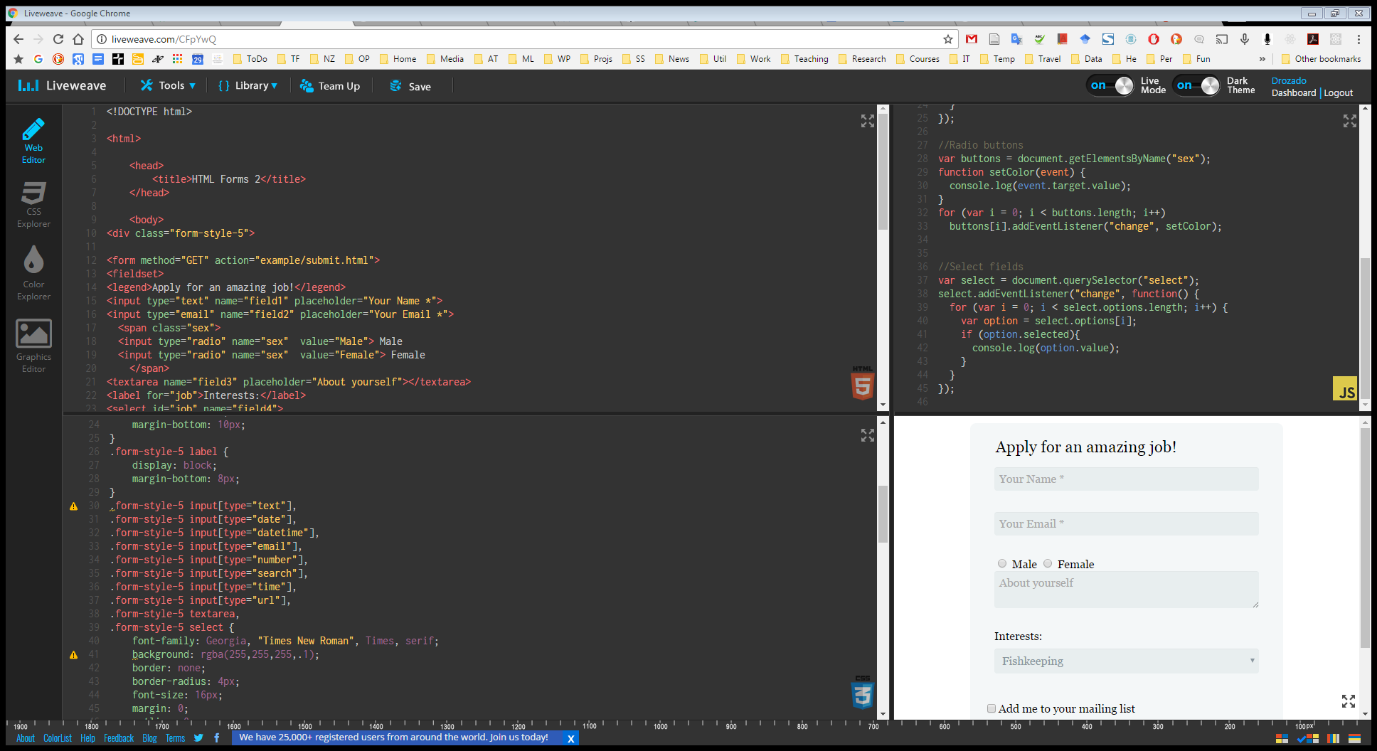
Demo 2

